Slide 1
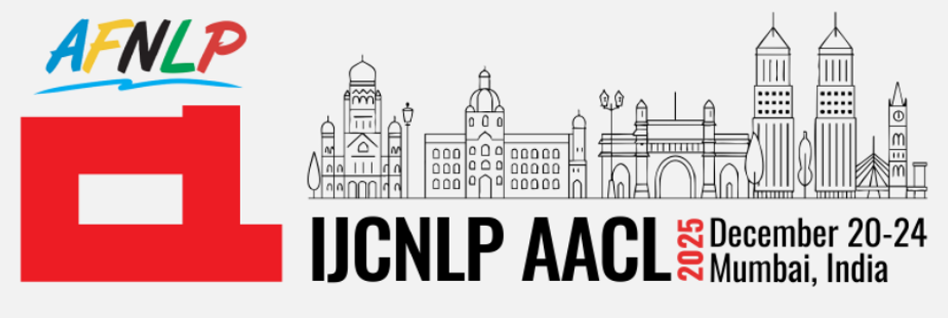


Continual Learning for Large Language Models
Dr. Srijith P. K.
Department of Computer Science and Engineering
Department of Artificial Intelligence (Affiliated)
Indian Institute of Technology Hyderabad
https://www.iith.ac.in/cse/srijith/
https://sites.google.com/view/brainiith/home
srijith@cse.iith.ac.in
Bayesian Reasoning And INference

Slide 2
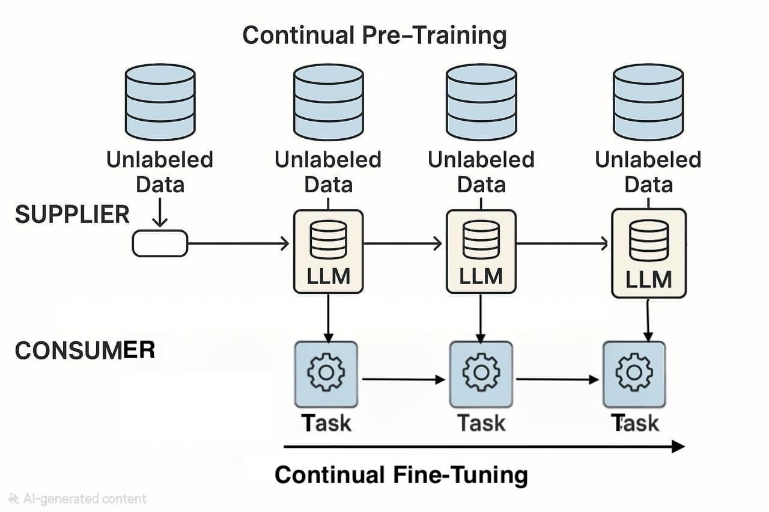
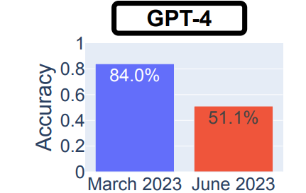
Large Language Models in Practice
On the supplier side, the model is continually pre-trained over a sequence of large-scale unlabeled datasets. After every release of the pre-trained model, the consumer utilizes the stronger and more up-to-date upstream model for downstream tasks. This cycle is repeated multiple times..
Performance drop in Prime vs. Composite Classification of GPT4 model
Chen, L., Zaharia, M. and Zou, J., 2024. How is ChatGPT’s behavior changing over time?. Harvard Data Science Review, 6(2).

Slide 3
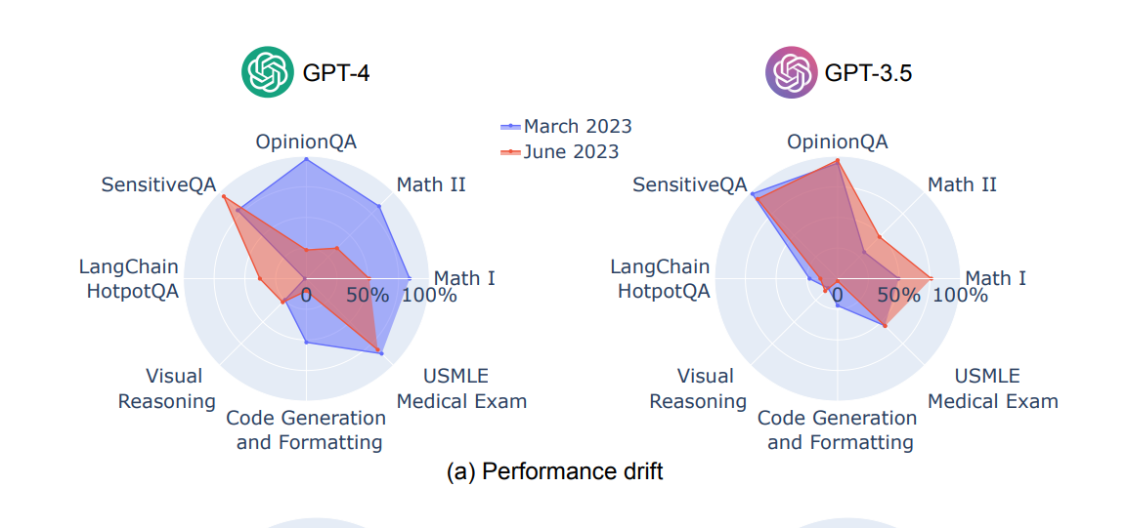
Continual Learning in LLMs
GPT-4 performance dropped from March to June 2023 across multiple categories (Math, Reasoning, OpinionQA, Code), while GPT-3.5 improved in several of the same tasks.
These opposing shifts show that model updates can alter capabilities unpredictably, reinforcing the need for more stable and continual learning approaches.
Chen, L., Zaharia, M. and Zou, J., 2024. How is ChatGPT’s behavior changing over time?. Harvard Data Science Review, 6(2).

Slide 4
Continual Learning in LLMs: Why Static Training is Insufficient in a Dynamic World
Large Language Models are trained on static datasets but deployed in non-stationary, evolving environments. Continual Learning (CL) enables incremental adaptation while mitigating catastrophic forgetting, making LLMs viable as long-lived systems.
Key Application Areas:
1. Lifelong Domain Specialization Incremental acquisition of domain knowledge (medicine, law, finance) without erasing general language competence or earlier expertise.
2. Knowledge Updating Over Time Efficient integration of new facts, events, and scientific findings without full retraining.
3. Personalization and User Adaptation Progressive alignment to user preferences, expertise levels, and interaction styles in long-term deployments.
4. Sequential Skill Acquisition Learning new capabilities (tool use, reasoning strategies, APIs) as tasks evolve, supporting curriculum-based model growth.
5. Alignment and Safety Refinement Continuous updating of safety constraints, ethical norms, and deployment-specific policies without behavioral regression.
6. Multimodal Expansion Incremental integration of new modalities (vision, audio, code) while preserving existing linguistic competence.
Key Challenge: Balancing plasticity and stability under non-stationary data distributions remains the central challenge in applying Continual Learning to LLMs.

Slide 5
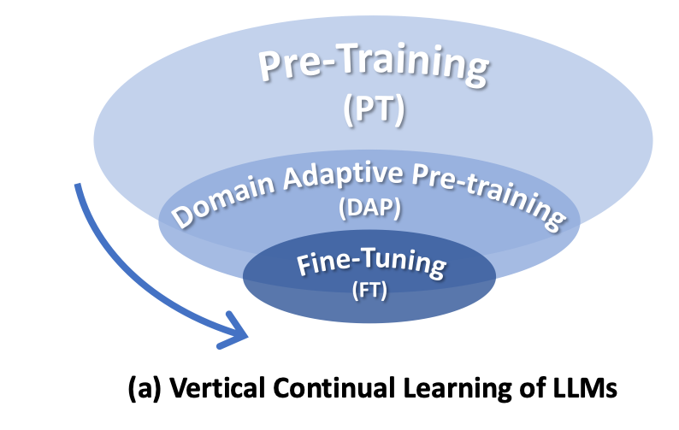
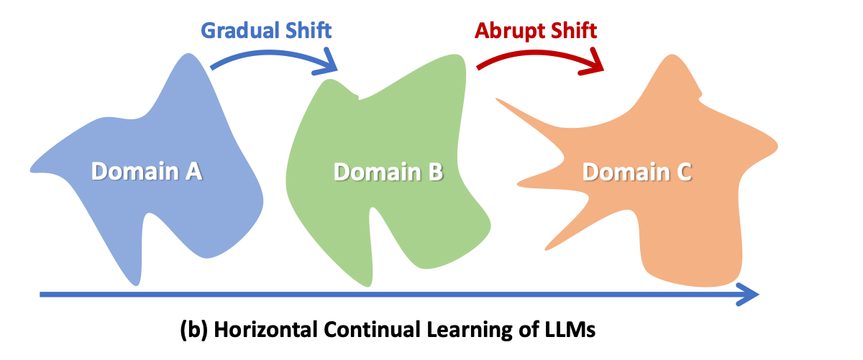
Continual Learning in LLMs
LLMs are trained on static data, but the world changes constantly (can be addressed through RAG)
Retraining from scratch is slow and expensive
Continual learning enables LLMs to update with new information, retain old knowledge, adapt to new domains and behaviours incrementally
LLMs would require broadly 2 kinds of continual learning
Horizontal continuity lies in the dynamic nature of data distribution over time.
Vertical continuity is characterized by a hierarchical structure, the data distribution of upstream tasks partially covers the downstream
Vertical tasks often reuse the same input-output mapping; less parameter interference.
Parameter-efficient methods (LoRA, adapters) let us isolate minute adjustments cheaply.
Horizontal Continuity the model needs to handle overlapping representations and update and addition of new data and preferences.
Continual Learning of Large Language Models: A Comprehensive Survey. ACM Comput. Surv. 58, 5, Article 120 (April 2026)

Slide 6
CL in LLM : Vertical Continuity
Vertical continuity is characterized by a hierarchical structure encompassing data inclusiveness, task scope, and computational resource
the data distribution of upstream tasks partially covers the downstream : model might start of at a decent initialization for the subsequent stage of training
Task Heterogeneity. Stemming from the inherent disparity between the formulation of upstream tasks and downstream task
Inaccessible UPstream Data : Data collected and curated under diferent protocols may not
be accessible to some downstream entities.

Slide 7
CL in LLM : Horizontal Continuity
Horizontal continuity lies in the dynamic nature of data distribution over time.
LLMs struggle to retain complete knowledge of past experiences when adapting to new temporal domains, although they do demonstrate a higher level of robustness against catastrophic forgetting
During pre-training, one can typically afford the storage costs of retaining all historical data, rendering memory constraints meaningless.
Long Task Sequences. Horizontal continual learning ideally involves numerous incremental phases
Abrupt Distributional Shift. In contrast to vertical continuity, here distributional shifts are abrupt and unpredictable

Slide 8
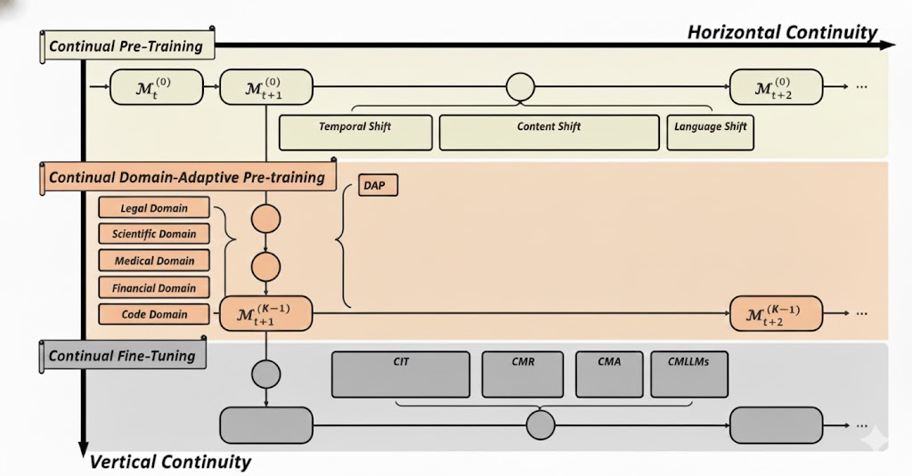
CL in LLMs

Slide 9
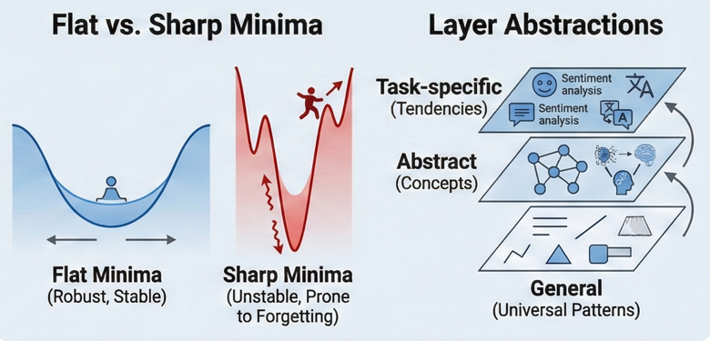
Why Continual Learning is Easier in LLMs
Pre-training places LLMs in a broad basin of parameter space
Trained on huge diversity: many domains styles, modalities, tasks
Leads to general reusable features
Training diversity forces optimization into stable regions not task-specific minimas
SGD on large heterogenous data : Flat Minima
Sharp minima = unstable
Flat minima = robust to small parameter perturbations; less catastrophic forgetting
Small updates during CL stays inside the same basin; easier knowledge retention
Why LLM CL Works Better
Pre-training diversity (Many domains, tasks)
Broad Basin (Stable Parameter Space)
Easier Continual Learning (Fine-tuning within stable Foundation)
Robustness (Less Catastrophic forgetting)
Result: LLMs start in a robust region of parameter space, so CL mostly fine-tunes within a stable foundation rather than learning from scratch

Slide 10
Continual Pre-Training: Adapting LLMs dynamically to new data
What CPT Is
Continuous pre-training on newly collected data (supplier side)
Top layer of Vertical Continuity: Avoids costly “retrain-from-scratch”
Maintains alignment as real-world distributions evolve
The Core Challenge: Distribution Shifts
Temporal Shift: New facts replace old ones (requires update + retention)
Content Shift: New Domains (Chemistry – Biology – Finance)
Language Shift: Acquiring new languages while preserving old ones.
Retention: Keep old knowledge stable (InvariantLAMA)
Target: Low FUAR = Forgotten / (Updated + Acquired)
Why CPT Is Needed
Static LLMs become outdated: Temporal Misalignment
CPT updates timestamp-sensitive, domain-shifting, and multilingual knowledge.
Acquisition: Learn new facts (NewLAMA)
Update: Replace outdated knowledge (UpdatedLAMA)
Efficiency + Techniques
Twiki-Diffsets: Train only on changed/new data
Architecture Expansion: LoRA, K-Adapter etc. freezes base model, adds new capacity.
Replay: Mix small % of prior corpus (sampling required for scale).
Regularization: EWC / parameter constraints based methods preserve critical weights.

Slide 11
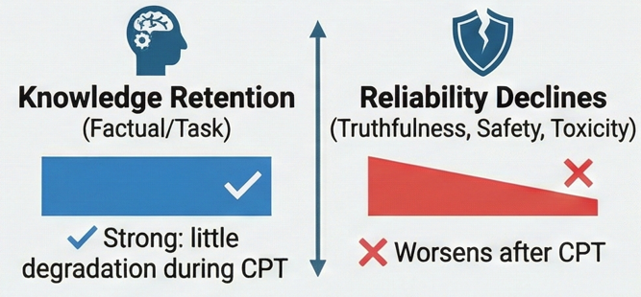
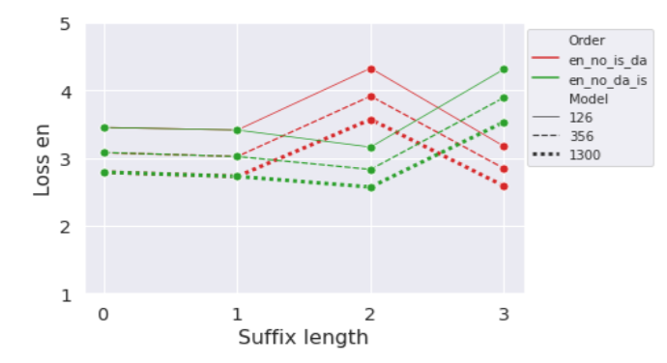



Distributional Shifts in CPT: Language Shift
Forgetting Patterns Vary across Languages
For a LLM initially trained on English corpora:
A
Knowledge vs. Reliability Under Language Shift
Models usually “remember” knowledge however alignment quality suffers.
Almost No Forgetting; Sometimes positive backward transfer
Mostly mild, sometimes positive, sometimes slight forgetting.
Consistent catastrophic forgetting of previously learned languages
Why Language Shift is Hard to Solve
Forgetting is not trivial; Simple freezing, partial freezing or naïve mixing strategies are not sufficient.
Larger LLMs lower overall loss however the trend remains the same
[63] E. Gogoulou, T. Lesort, M. Boman, and J. Nivre. Continual learning under language shift, 2024.
[118] C.-A. Li and H.-Y. Lee. Examining forgetting in continual pre-training of aligned large language models, 2024

Slide 12
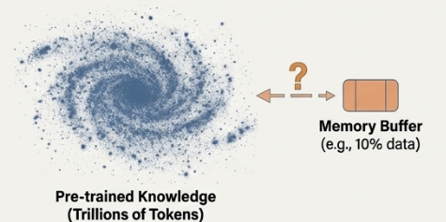
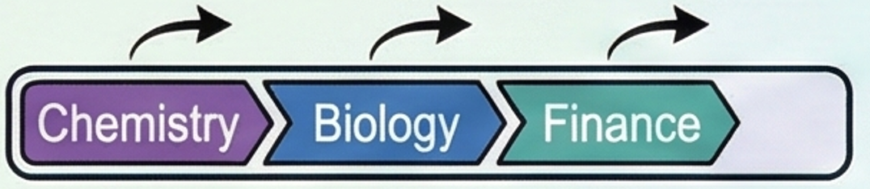
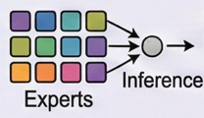
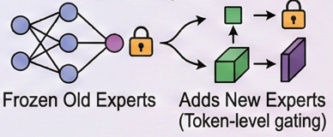
Distributional Shifts in CPT: Content Shift
Content Shift is Common and Beneficial but Challenging
Large-scale CPT over 159 domains shows strong gains in adaptation ability vs. single-domain DAP.
Sequentially learning new fields (e.g., chemistry → biology → finance) requires domain-specialization without forgetting earlier content.
Insights from Recent studies
Learning-rate rewarming + re-decay + limited replay can match the performance of full retraining.
Contrary to Common CL, experience replay is often ineffective in CPT due to overfitting risks and scale limitations.
At LLM scale, replay becomes infeasible and even slows adaptation to new domains.
Why Replay fails In CPT
The sheer volume of pre-training corpora makes replay buffers computationally unrealistic.
CPT differs from typical CL: preventing forgetting cannot come at the cost of inhibiting domain learning.
Effective Strategies for Handling Content Shift
DEMix Layers Incrementally train & mix experts probabilstically
Sequentially Learning new fields
Lifelong-MoE
Key Takeaway: Content shifts require balancing rapid domain adaptation with minimal interference to prior knowledge. Replay alone is insufficient—modular, expandable, or scheduler-based strategies work best.
Structured Scheduling
(LR rewarm + decay) Smooth transitions between domains
Qin, Yujia, et al. "Recyclable tuning for continual pre-training." arXiv preprint arXiv:2305.08702 (2023).
Gururangan, Suchin, et al. "Demix layers: Disentangling domains for modular language modeling.“
Chen, Wuyang, et al. "Lifelong language pretraining with distribution-specialized experts." International Conference on Machine Learning. PMLR, 2023.

Slide 13
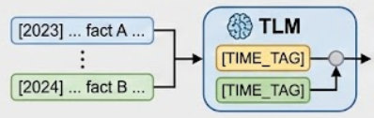
Distributional Shifts in CPT: Temporal Shift
Why Temporal Shift Is Uniquely Challenging
Temporal shifts introduce conflicting facts over time.
Unlike content or language shift, we don’t want to retain outdated facts, we need to update them.
Multi-task training struggles when tasks contain mutually inconsistent knowledge.
The Three Core Objectives of Temporal CPT
To remain temporally aligned, CPT must simultaneously:
Retain stable, time-invariant knowledge.
Acquire new knowledge emerging in the latest data.
Update outdated or incorrect knowledge.
What Research Finds About CPT Under Temporal Shift
Continuous Knowledge Learning compares different traditional CL methodologies for CPT and finds that:
Parameter expansion (new modules, frozen base) is consistently robust.
Replay-based methods struggle—they slow acquisition of new facts and impede updates.
TemporalWiki Builds sequential Wikipedia snapshots and differential corpora (only changed/new facts). They show that training on diff-sets dramatically improves new knowledge acquisition and updating.
Time T1 (Past) Messi Plays for Barcelona
Time T2 (Present) Messi Plays for Inter Miami
CONFLICT
Temporal Language Models (TLMs): A Different Solution Path
Inject explicit temporal information into the model that helps LLMs disambiguate time-dependent facts, supporting retention + update without conflict.
J. Jang, S. Ye, S. Yang, J. Shin, J. Han, G. Kim, S. J. Choi, and M. Seo. Towards continual knowledge learning of language models. In ICLR J. Jang, S. Ye, C. Lee, S. Yang, J. Shin, J. Han, G. Kim, and M. Seo. Temporalwiki: A lifelong benchmark for training and evaluating ever-evolvinglanguage models. 2022.

Slide 14
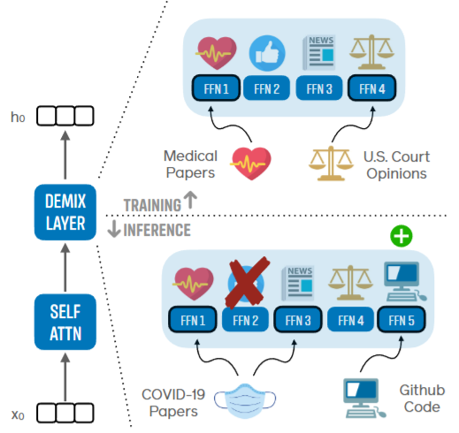
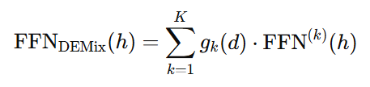
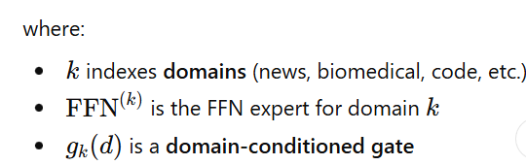
DEMIX Layers: Disentangling Domains for Modular Language Modeling
The Methodology: Replace monolithic FFNs with modular, domain-specific experts.
Core Idea: The Domain Expert Mixture (DEMIX) layer is a drop in replacement for the standard FFN layer in a transformer.
Mechanism: Instead of one FFN, DEMIX uses a collection of expert FFNs. During training each document is routed to the expert corresponding to its domain label.
Key Feature: This creates a modular architecture where domain-specific knowledge is disentangled into separated components, while shared parameters (like attention layers) are still learned across all data
Motivation: Monolithic LLMs Struggle with adaptation and control
Standard “dense training” updates all parameters on all data, leading to significant catastrophic forgetting
DEMIX Layers : Idea
Most domain-specific and factual knowledge in Transformers is stored in FFN layers, not attention layers.
DEMix layers implement domain-conditioned FFN experts, trained incrementally and frozen across CPT steps, yielding architectural guarantees against catastrophic forgetting
Gururangan, Suchin, et al. "Demix layers: Disentangling domains for modular language modeling." Proceedings of the 2022 Conference of the North American Chapter of the Association for Computational Linguistics: Human Language Technologies. 2022.

Slide 15
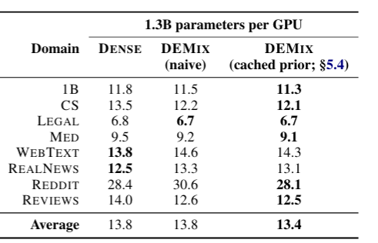
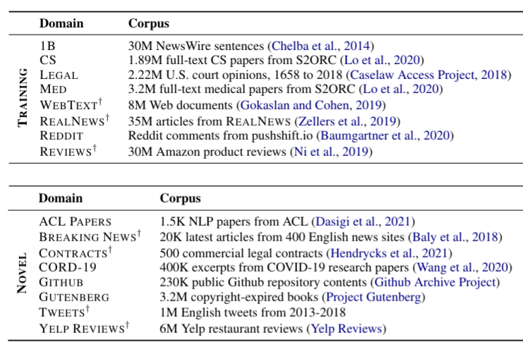

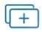

DEMIX Layers: Disentangling Domains for Modular Language Modeling
Results: Dynamic expert mixing leads to better generalization
At inference time, we can form a parameter-free, weighted ensemble of experts to handle data from unseen or heterogeneous domains. This is done by estimating a posterior probability over domains for the input text.
Mix Handle Heterogenous and unseen domains by dynamically combining experts using a Bayesian approach at test time
Add Adapt to new domains without catastrophic forgetting by adding a new expert and training only it’s parameters and keeping the rest of the model frozen.
Remove Control model behaviour by disabling domains. Simply deactivate a expert at inference time to simulate a model never trained on that data. Offering a lightweight mechanism to restrict access to unwanted data.
Gururangan, Suchin, et al. "Demix layers: Disentangling domains for modular language modeling." Proceedings of the 2022 Conference of the North American Chapter of the Association for Computational Linguistics: Human Language Technologies. 2022.

Slide 16
DEMIX Layers: Disentangling Domains for Modular Language Modeling
Results: Dynamic expert mixing leads to better generalization
At inference time, we can form a parameter-free, weighted ensemble of experts to handle data from unseen or heterogeneous domains. This is done by estimating a posterior probability over domains for the input text.
DRAWBACK ?
Mix Handle Heterogenous and unseen domains by dynamically combining experts using a Bayesian approach at test time
Add Adapt to new domains without catastrophic forgetting by adding a new expert and training only it’s parameters and keeping the rest of the model frozen.
Remove Control model behaviour by disabling domains. Simply deactivate a expert at inference time to simulate a model never trained on that data. Offering a lightweight mechanism to restrict access to unwanted data.
Gururangan, Suchin, et al. "Demix layers: Disentangling domains for modular language modeling." Proceedings of the 2022 Conference of the North American Chapter of the Association for Computational Linguistics: Human Language Technologies. 2022.

Slide 17
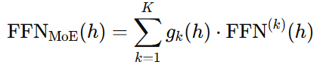
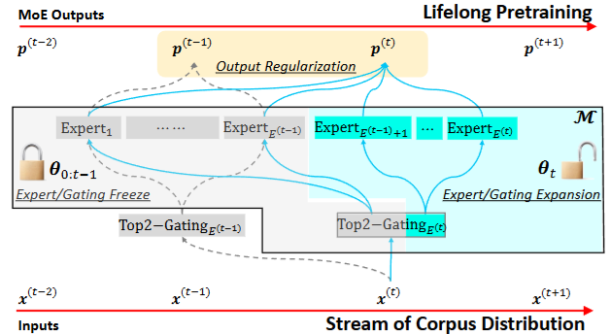
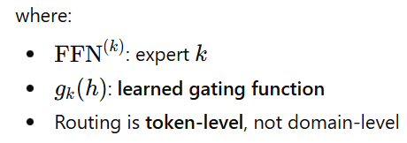
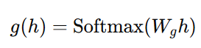
Lifelong Language Pretraining with Distribution-Specialized Experts
Methodology: Adresses drawbacks of DEMIX - no explicit domain labels, regularization over shared parameters
The methodology is balanced on three pillars.
Progressive Expert Expansion: The MoE architecture’s capacity in dynamically increased by adding new, specialized experts for each new data distribution. This avoids overwriting existing parameters.
Knowledge Preservation via Freezing: Previously trained experts and their corresponding gating layers are frozen. This explicitly protects learned knowledge from being erased during training on new data.
Implicit Regularization via Distillation: Shared components of the network (e.g., attention layers) are guided using knowledge distillation from the model’s previous state. This prevents them from drifting too far while still allowing adaptation to new data.
Routing depends on hidden representation
Chen, Wuyang, et al. "Lifelong language pretraining with distribution-specialized experts." International Conference on Machine Learning. PMLR, 2023.

Slide 18
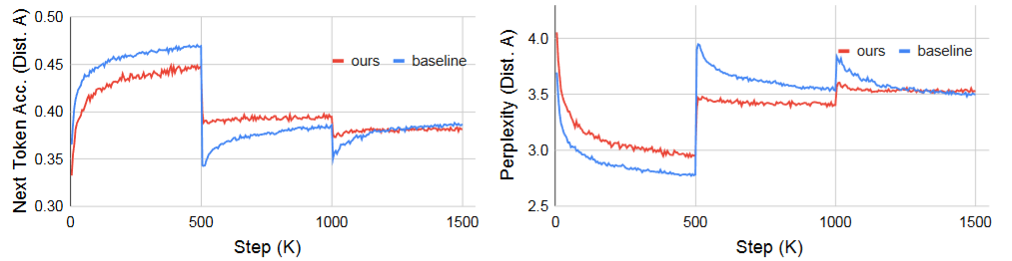
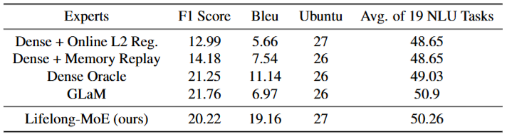
Lifelong-MoE: Results
Lifelong-MoE maintains performance on previously learned distributions, directly preventing the catastrophic forgetting observed in standard sequential pretraining
Next-Token Accuracy on Distribution A (Each distribution is trained for 500K)
Lifelong-MoE not only dramatically reduces forgetting buy also achieves competitive or state of the art performance outperforming strong baselines like Memory Replay and even a Dense Oracle model trained jointly on all data for specifc tasks (e.g., translation)

Slide 19
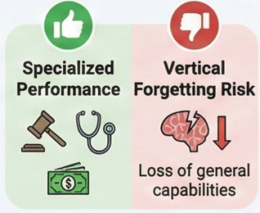
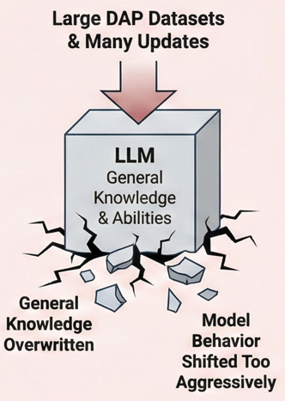
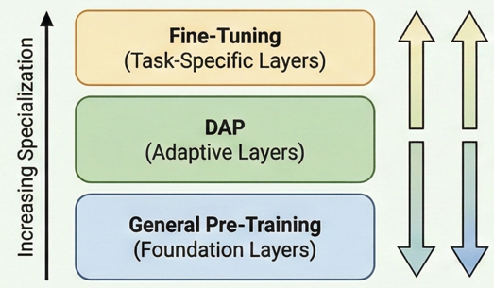
Domain Adaptive Pre-Training
What DAP is & Why it matters
Key Observations
From the Literature
DAP is usually a single-stage process Multi-stage or Continual DAP is rare.
DAP is already being treated as CL CL concepts are used without naming them: replay = “data mixing”, adapters = “domain adapters”
Diversity of CL techniques used in DAP is limited Most papers rely on replay & LoRA / Adapters Other CL strategies remain underexplored
The Core Challenge: Vertical Forgetting
DAP usually damages performance on general tasks (safety, reasoning & Instruction-Following.
Initial LLM Pre-Training (General Data)
DAP (Domain-Specific Unlabeled Data)
Downstream Fine-Tuning (Task Data)
Improves performance on specialized (e.g., Legal, Medical Financial)
How DAP fits into Vertical Continuity
General pretraining underrepresents specialized domains. DAPT corrects this distributional mismatch.
Updating with New Domain Knowledge
Preserving
General-Purpose Abilities (Reasoning, Language, Commonsense)
CDAPT is a special case of CPT where the data stream corresponds to a sequence of clearly defined domains, and the goal is progressive domain adaptation while retaining general capability.
Key Takeaway: DAP is powerful for domain specialization however risks eroding general capabilities. More sophisticated CL-aware techniques are needed to retain generality while adapting deeply.

Slide 20
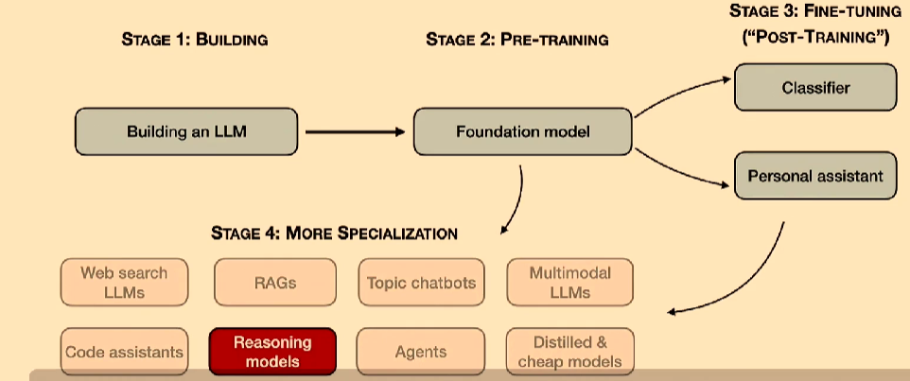
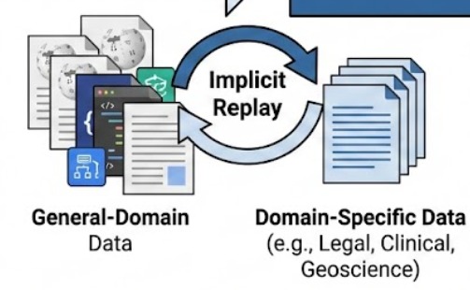
Domain Adaptive Pre-Training: CL Techniques in Practice
Replay appears Implicitly in DAP Pipelines
Key Observations:
This implicitly functions as experience replay
Goal: reduce vertical forgetting of general capabilities
Example | Replay mechanism | Mixing amount / ratio
SaulLM [42] | Mixes a small amount of general data into legal-domain DAP | 2% general-domain
RedPajama replay [43] | Replays general data in a small fraction of DAP batches | 5% batch rate
Me-LLaMA [265] | Mixes general data when adapting to clinical/biomedical domains | ~25% general-domain
HuatuoGPT-II [33] | Uses priority sampling to avoid issues from fixed-rate mixing | Priority sampling (no fixed %)
GeoGalactica [129] | Mixes geoscience (52B tokens), arXiv papers, and code data | 8:1:1 (Geoscience:arXiv:CodeData)

Slide 21
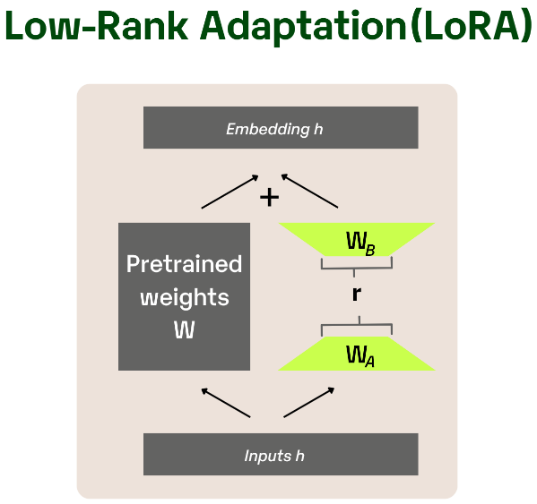
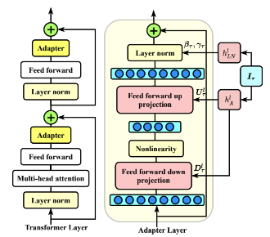
Domain Adaptive Pre-Training: CL Techniques in Practice
Adapter-Based & LoRA-Based DAP (Architecture Expansion)
Why Architecture Expansion Works:
Adds new task capacity
Preserves general-domain representations
Limits interference → less catastrophic forgetting
Adapter-Based DAP:
AF Adapter: Expands attention & FFN widths → Only adapters trained → Strong resistance to vertical forgetting
LoRA-Based DAP:
Hippocrates: Injects medical knowledge via LoRA → Preserves general reasoning ability
IRCoder: LoRA on compiler IR representations → Improves multilingual code instruction following
LLaMA Pro: Adds multiple identity copies of transformer blocks → Later tuning → stronger forgetting resistance than vanilla LoRA
Key Takeaway: Replay, Adapters/LoRA, and Regularization all act as continual learning mechanisms—often unintentionally—to prevent vertical forgetting during DAP. This shows that DAP is already a CL process, requiring deliberate strategies to preserve general-purpose LLM capabilities.

Slide 22
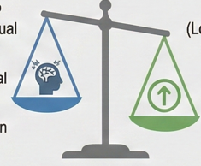

Continual Fine-Tuning: Bottom Layer of Vertical Continuity
What CFT Is
CFT lies at the bottom layer of the vertical continuity hierarchy.
The model is trained on successive homogeneous tasks drawn from an evolving (but relatively stable) data distribution.
Why CFT is easier than CPT/DAP
Key Sub Areas of CFT
CPT/ DAP
(Global Continual Alignment)
Balance General Knowledge Retention vs. Domain Injection
CFT
(Local Improvement)
Focus on Direct Task Adaptation
Continual Instruction Tuning (CIT) Sequential instruction datasets, improving reasoning & alignment
Continual Model Refinement (CMR) Ongoing Improvement of base models with updated data
Continual Model Alignment (CMA) RLHF/DPO style updates done sequentially for safety and trustworthiness.
Lower Catastrophic forgetting due to more homogeneous tasks
Simpler optimization and CL constraints
CL techniques in LLM are most actively explored in CFT.
CL techniques such as Regularization, parameter Isolation and replay style sampling are widely used and effective.
Although the pre-trained weights initially position the model in a lat-loss basin, aiding adaptation, zero or near-zero forgetting is only observed at the representation level. Model retains its ability to distinguish between task-speciic representations, it may still forget speciic task details

Slide 23
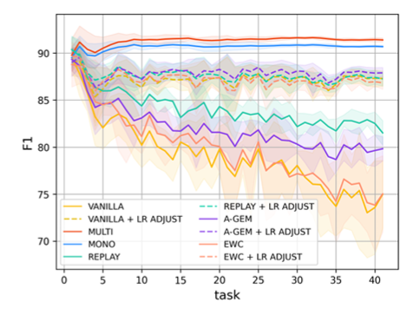
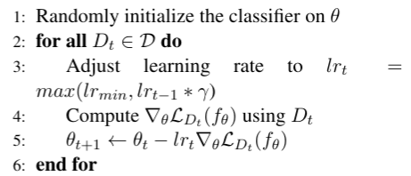
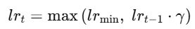
Continual Fine tuning
Approaches leverage the inherent anti-forgetting nature of LLMs while avoiding the adoption of overly complex CL techniques
LR ADJUST [255] proposes dynamically adjusting the learning rate to mitigate the overwriting of knowledge from new languages onto old ones.
Lower base LR for later tasks, Task-dependent LR scaling, Layer-wise LR decay, where:Lower (foundational) layers receive smaller updates and Higher (task-specific) layers adapt more aggressively
Limitations : Cannot fully prevent forgetting under strong domain/task shiftsSensitive to LR scheduling choices
Winata, G. I., Xie, L., Radhakrishnan, K., Wu, S., Jin, X., Cheng, P., Kulkarni, M., & Preotiuc-Pietro, D. (2023). Overcoming catastrophic forgetting in massively multilingual continual learning. Findings of the Association for Computational Linguistics: ACL 2023,
multilingual natural language understanding data set, MASSIVE (FitzGerald et al., 2022)

Slide 24
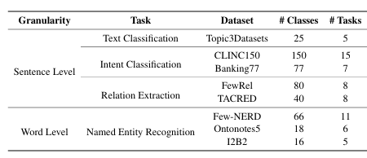
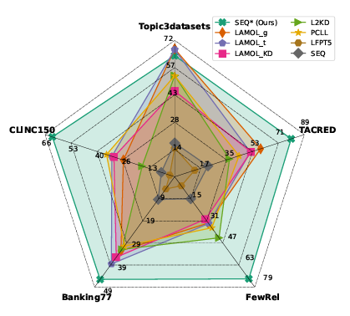
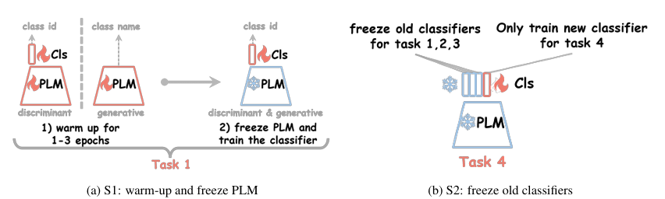
Continual Fine tuning
Some works[1,2] introduce strategies for fine-tuning LLMs on a sequence of downstream classification tasks, such as freezing the LLM and old classifier’s parameters after warm-up (LLM and classifier are trained jointly on the first task for a short period), and allocating new classifier head for future tasks.
J. Zheng, S. Qiu, and Q. Ma. Learn or recall? revisiting incremental learning with pre-trained language models, 2023.
Zhang et. Al. Pythia: A suite for analyzing large language models across training and scaling, ICML 2023

Slide 25
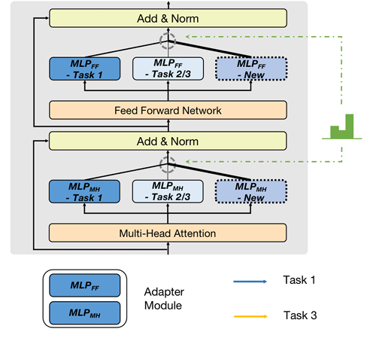
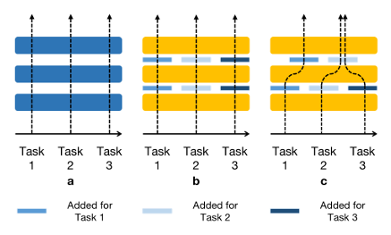
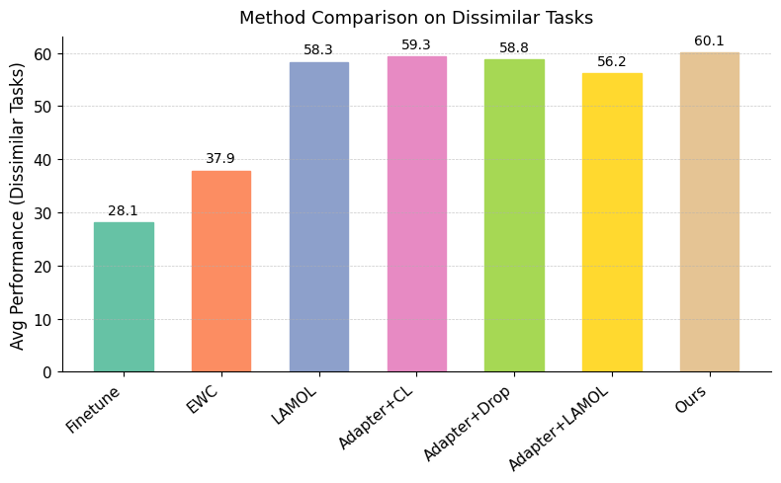
CFT- compositional Adapters
In [291], the authors propose a method for adaptively adding compositional modules (adapters) during continual sequence generation tasks. Before training on new domains, a decision stage determines which trained module can be reused.
Hidden state mixing: For each transformer layer, the model evaluates all existing modules (from previous tasks) and a newly added module.
Combines output of each module using a weighted average of their outputs
Model learns weight coefficients and newly added module
The module with the highest learned weight is considered the most useful and is selected for reuse.
Y.Zhang,X.Wang,andD.Yang. Continual sequence generation with adaptive compositional modules. In S. Muresan, P. Nakov, and A. Villavicencio,, ACL 2022

Slide 26
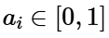
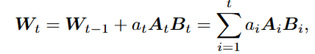
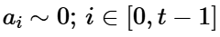
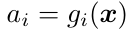
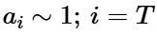
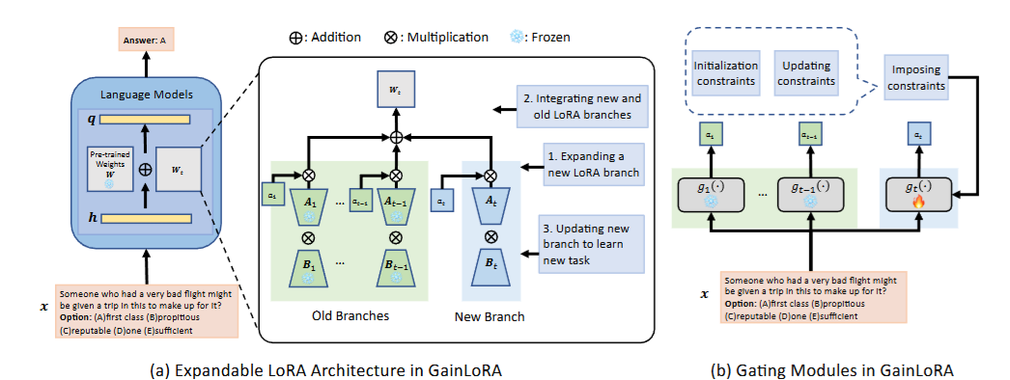

GainLoRA: Gated Integration of Low-Rank Adaptation for Continual Learning
In several practical situations, actual task ID is not known.
Existing solutions simply add all the separate LoRA branches together to form the final output (Model Merging). To address the issue of uncontrolled interference caused by simple branch addition, GainLoRA - introduces gating modules to integrate the new and old LoRA branches. Core Innovation: Task-wise Gating Introduces independent gating modules for each task. Each gate outputs a learned integration coefficient that determines the influence of the i-th LoRA branch
Impose orthogonality constraints to guide g_{t}(x) close to 0 for any x from the old tasks
Performance evaluation of SuperNI benchmark - dialogue generation, information extraction, question answering, summarization, and sentiment analysis
Liang, Yan-Shuo, and Wu-Jun Li. Gated Integration of Low-Rank Adaptation for Continual Learning of Language Models (GainLoRA) NeurIPS 2025

Slide 27




Continual Instruction Tuning: Learning from Evolving Instruction Streams
Key Techniques Used in CIT
What is CIT?
When Instruction datasets arrive as a stream. Requires learning new instructions without forgetting the previous ones.
Replay Based Methods
KPIG Replay[80]: Uses Key Part Information Gain for dynamic replay selection, reducing “half listening”.
SSR[89]: Uses LLM to generate synthetic replay data, lowering compute cost while preserving skills.
Regularization + Replay Hybrids
DynaInst[165]: Selective replay + parameter regularization for stable learning.
InstructionSpeak[279]: Adds negative training & replay instructions for improved fwd/bwd transfer.
PEFT-Based Approaches
O-LoRA[240]: Learns new instructions in orthogonal subspace, preserving older LoRA weights; minimizes interference.
SAPT[297]: Shared attentive learning + selection module to manage knowledge transfer and forgetting jointly.
Instruction Stream
LLM Model
Why CIT is Unique?
Instruction data is sequential and heterogeneous. (new tasks, formats, and reasoning patterns.)
Forgetting manifests as reduced instruction-following ability ("half-listening" effect).
rich natural language instructions enable knowledge transfer and reduce forgetting,
Each instance dτ in the task τ forms a triple(i,c,y)
Benchmarks & Evaluation
SuperNI dataset, which is a benchmark for instruction tuning
Trace: Continual instruction tuning benchmark - Multilingual, Coding & Math Reasoning tasks
CITB: continual instruction tuning benchmark - dialogue task streams of different types,
CoIN: Extends CIT to Multimodal models.

Slide 28

Y. He, X. Huang, M. Tang, L. Meng, X. Li, W. Lin, W. Zhang, and Y. Gao. Don’t half-listen: Capturing key-part information in continual instruction tuning, ACL 2024.
CIT - Key-Part Information Gain (KPIG)
Replay also introduces semantic interference, and the model begins to shortcut to the lowest-effort interpretation , following only primary verb and ignoring modifiers.
Half-Listening Problem — where the model partially follows instructions because prior replay or fine-tuning emphasized only fragments of meaning.
Improve replay efficiency by computing Key-Part Information Gain (KPIG) on masked parts to dynamically select replay data, addressing the “half-listening” issue in instruction following.
Key parts are consecutive spans in the instruction which provide task-aware guidance on the content, length, and format to generate desired responses..
KPIG (Key-Part Information Gain)This is used to rank training or replay examples based on how much critical semantic information they carry
Masking important phrase spans in the instruction (e.g., goals, constraints, modifiers).Measuring how much the model’s confidence drops when these masked parts are removed. p(output | full instruction) Vs. p(output | masked instruction)
High KPIG score means the the example teaches the model complex instruction-following, and hence training or replaying it is beneficial for avoiding partial compliance behavior.
Computes KPIG for all candidate replay samples, Selects only those with high KPIG for replay
Notes:
Replay also introduces semantic interference, and the model begins to shortcut to the lowest-effort interpretation to minimize conflicting gradients across tasks.
Even when there is no replay, instruction-tuned LLMs sometimes:
Follow only the primary verb ("translate")
Ignore modifiers ("only output the noun", "keep the same format", etc.)
Drop constraints ("in JSON", "limit to 3 sentences")
This happens because:
Many instruction datasets are imbalanced: simple tasks are far more frequent than complex multi-constraint ones.
In continual learning, especially with naïve replay, the problem becomes more pronounced.
Why?
Because replay tends to:
Sample old examples uniformly
Replay simpler instructions more often than complex ones
Compress the memory of past domains due to limited capacity

Slide 29






) Y. He, X. Huang, M. Tang, L. Meng, X. Li, W. Lin, W. Zhang, and Y. Gao. Don’t half-listen: Capturing key-part information in continual instruction tuning, ACL 2024.
CIT - Key-Part Information Gain (KPIG
Information gain (IG) by masking key parts in each instance
High KPIG score means the the example teaches the model complex instruction-following, and hence training or replaying it is beneficial for avoiding partial compliance behavior.
select M seen tasks with the lowest mean IG as replay tasks : Low information gain indicates that the model is not effectively capturing the task-specific constraints in the instruction.
SupNatInst consists of over 1000 NLP tasks and 76 categories (e.g., text classification, information extraction and etc.) (Wang et al., 2022). e select 128 tasks in 40 categories from SupNatInst, 88 tasks are used for training Tseen and 40 as held-out tasks
Notes:
Replay also introduces semantic interference, and the model begins to shortcut to the lowest-effort interpretation to minimize conflicting gradients across tasks.
Even when there is no replay, instruction-tuned LLMs sometimes:
Follow only the primary verb ("translate")
Ignore modifiers ("only output the noun", "keep the same format", etc.)
Drop constraints ("in JSON", "limit to 3 sentences")
This happens because:
Many instruction datasets are imbalanced: simple tasks are far more frequent than complex multi-constraint ones.
In continual learning, especially with naïve replay, the problem becomes more pronounced.
Why?
Because replay tends to:
Sample old examples uniformly
Replay simpler instructions more often than complex ones
Compress the memory of past domains due to limited capacity

Slide 30


CIT : Self-Synthesized Rehearsal
Conventional rehearsal-based methods rely on previous training data to retain the model’s ability, which may not be feasible in real-world applications, for instance CL on publicly released LLM checkpoint
Self-Synthesized Rehearsal (SSR) that uses the LLM to generate synthetic instances for rehearsal.
the base LLM to generate synthetic instances, conducting in-context learning (ICL) with few-shot demonstrations (The ICL ability of LLMs tends to exhibit a significant degradation after supervised fine-tuning (SFT) on specific tasks)
latest LLM is used to refine the outputs of synthetic instances (synthetic instance retains the knowledge acquired by the latest LLM.)
select diverse high-quality synthetic instances for rehearsal (through clustering)
Llama-2-7b and SuperNI dataset (Wang et al., 2022)
J.Huang,L.Cui,A.Wang,C.Yang,X.Liao,L.Song,J.Yao,andJ.Su. Mitigatingcatastrophicforgettinginlargelanguagemodelswithself-synthesized rehearsal, ACL 2024.

Slide 31




CFT - Orthogonal LORA
Introduce O-LoRA, a simple and efficient approach for continual learning in language models, incrementally learning new tasks in orthogonal subspaces
Orthogonal Gradient Descent (OGD) needs to store gradients of all previous data - intractable for large-scale language models, used PEFT based on LORA
Hypothesis : LoRA parameters encapsulate crucial model update directions. Therefore, the gradient subspaces of previous tasks are succinctly represented by the LoRA parameters.
Llama &B trained on – Alpaca data set - open-source multitask instruction tuning dataset introduced by Taori et al. (2023) Tasks from various domains, such as STEM, humanities, social sciences, and general knowledge.
Tested on MMLU data set - Massive Multitask Language Understanding designed to evaluate the general knowledge and problem-solving

Slide 32

Continual Model Refinement: Post Deployment Improvement of LLMS
What Is CMR
CMR is the recurring and incremental process of improving or correcting a deployed LLM.
Deployed language models decay over time due to shifting inputs, changing user needs, or emergent world-knowledge gaps. When such problems are identified, we want to make targeted edits while avoid modifying behaviors of pre-trained models.
CMR allows safe, targeted, and continual improvement of a deployed LLM. Modern methods use model editing, retrieval-triggered updates and parameter isolation (e.g., LoRA experts) to avoid broad interference and maintain alignment.
Notes:
While retraining or finetuning can edit a model’s predictions, doing this frequently is often too computationally expensive. LLaMA [40], for instance, was trained for 21 days on 2,048 A100 GPUs, costing over $2.4M and emitting over 1,000 tons of CO2.

Slide 33


Lifelong Model Editing with Discrete Key-Value Adaptors
This method treats hidden representations of the language model as a similarity key to decide when to use the updated parameters for a new task.
GRACE enables targeted, non-destructive model edits by adding a lightweight key–value memory at selected layers, rather than modifying the model’s original weights.
How it works
Each edit stores: (h^{l−1},v)
a key (representing a latent activation pattern h^{l−1})
a value (the corrected or updated behavior v, learnt by fine tuning)
an influence radius (ε) controlling when the edit applies
Deferral decision at inference
At each GRACE-enabled layer, the model:
Treats the current hidden activation as a query
Searches for the closest stored key
If the query is similar enough (distance < ε): GRACE uses the value
Else falls back to the original pretrained computation
T. Hartvigsen, S. Sankaranarayanan, H. Palangi, Y. Kim, and M. Ghassemi. Aging with grace:
Lifelong model editing with discrete key-value adaptors. In Advances in Neural Information Processing Systems, 2023.
Notes:
, [74] uses hidden activations of the language model as a “key” to activate updated parameters only when input 𝑥0 resembles updated sample pairs; [280] improves this approach’s efficiency by integrating LoRA [86]; [45] augments the LLM with an external episodic memory, modeling CMR as an ongoing memory refresh’
T. Hartvigsen, S. Sankaranarayanan, H. Palangi, Y. Kim, and M. Ghassemi. Aging with grace: Lifelong model editing with discrete key-value adaptors. In Advances in Neural Information Processing Systems, 2023.
L. Yu, Q. Chen, J. Zhou, and L. He. Melo: Enhancing model editing with neuron-indexed dynamic lora. arXiv preprint arXiv:2312.11795, 2023.

Slide 34

Lifelong Model Editing with Discrete Key-Value Adaptors
This method treats hidden representations of the language model as a similarity key to decide when to use the updated parameters for a new task.
GRACE enables targeted, non-destructive model edits by adding a lightweight key–value memory at selected layers, rather than modifying the model’s original weights.
Experiments to correct hallucination: GPT-3 to generate 238 wikipedia-style biographies using subjects from WikiBio. Edits for all 238 biographies, creating 1392 sequential edits and 592 already-accurate outputs.
Test RetentionRate (TRR): Edited model retains its performance on original testing data
Edit Retention Rate (ERR): We check how well an edited model retains previous edits
Metric used is perplexity - lower the better
T. Hartvigsen, S. Sankaranarayanan, H. Palangi, Y. Kim, and M. Ghassemi. Aging with grace:
Lifelong model editing with discrete key-value adaptors. In Advances in Neural Information Processing Systems, 2023.
Notes:
, [74] uses hidden activations of the language model as a “key” to activate updated parameters only when input 𝑥0 resembles updated sample pairs; [280] improves this approach’s efficiency by integrating LoRA [86]; [45] augments the LLM with an external episodic memory, modeling CMR as an ongoing memory refresh’
T. Hartvigsen, S. Sankaranarayanan, H. Palangi, Y. Kim, and M. Ghassemi. Aging with grace: Lifelong model editing with discrete key-value adaptors. In Advances in Neural Information Processing Systems, 2023.
L. Yu, Q. Chen, J. Zhou, and L. He. Melo: Enhancing model editing with neuron-indexed dynamic lora. arXiv preprint arXiv:2312.11795, 2023.

Slide 35



WISE: A Dual-Memory Architecture for Lifelong Editing
Existing methods for Continual refinement for LLMs fail to achieve reliability, Generalization and Locality. WISE resolves this by introducing a dual-memory system that isolates edits from the original model’s knowledge.
The Impossible Triangle in Lifelong Editing
Methods that edit model parameters (long-term memory e.g., ROME) suffer from poor locality, while retrieval based methods (working memory, e.g., GRACE) fail to generalize. This creates a fundamental trade-off.
Reliability: Remembering all past edits across a long sequence.
Generalization: Applying edits to paraphrased or semantically similar queries.
Locality: Ensuring edits do not affect unrelated knowledge in the model.
The WISE Solution: Dual Memory, Routing, and Sharding
Side Memory Creation: A copy of a specific FFN layer’s value matrix (w_v) is created to serve as a dedicated editable ‘side memory’ (W_v’)
Activation-Based Routing: A router determines if an input x is related to an edit by calculating (A(·) = a is the activation of the side memory’s corresponding FFN layer)
Knowledge Sharding: Incoming edits are distributed across distinct subspaces of the side memory defined by random masks. This prevents catastrophic forgetting.
Conflict-Free Merging: Periodically, the edited subspaces are merged into a single side memory using Ties-merge.
Wang, Peng, et al. "Wise: Rethinking the knowledge memory for lifelong model editing of large language models." Advances in Neural Information Processing Systems 37 (2024): 53764-53797.

Slide 36


Results: WISE Achieves Balanced, Scalable, and Superior Performance
Across diverse tasks and thousands of sequential edits, WISE consistently outperforms state-of-the-art model editors by successfully balancing the three key metrics of Reliability, Generalization and Locality.
WISE Overcomes the Impossible Triangle
(ZsRE QA Task, LLaMA-2-7B)
Key Takeaways
Breaks the Trade-Off: WISE is the only method to maintain high performance across all three metric.
Outperforms SOTA by a Wide Margin: The average score of 0.83 on the QA Task represents a significant jump over the next best method. In contrast GRACE’s generalization score collapses to 0.08
Robust & Scalable: This strong performance holds across models (LLaMA, Mistral, GPT-J), tasks (Question Answering, Hallucination Correction), and scales gracefully to 3,000+ edits, demonstrating true lifelong learning capability.

Slide 37

Continual Model Alignment
Why CMA is Needed
A single alignment stage (e.g., RLHF, DPO) can restrict the model’s behavior to a narrower distribution.
Alignment updates often overwrite previously learned preferences; This phenomenon is called the “Alignment Tax”
As factual knowledge, societal norms, and safety standards evolve, CMA ensures ongoing alignment with contemporary expectations.
Different CMA Approaches
RL Based CMA
Standard RLHF/DPO/STeER modifies many parameters at once, causing large behavioral shifts.
Adaptive Model Averaging (AMA): An alignment-aware continual adaptation mechanism that averages multiple model layers using adaptive weights to minimize alignment tax.
Continual Proximal Policy Optimization (CPPO): Learns example-level weighting to decide when to strengthen policy alignment vs. retain earlier behaviors.
SL-Based CMA
Frequent preference shifts require continual correction of supervised alignment datasets.
Continual Optimal Policy Fitting (COPF): An adaptation of DPO that mitigates sub-optimal policy fitting and prevents over-optimization under continual updates.

Slide 38





Mitigating the Alignment Tax of RLHF
The Alignment-Forgetting Trade-off
Reinforcement Learning from Human Feedback (RLHF) aligns LLMs with human preferences, but degrades performance on the pre-trained abilities of a model (general language modelling – reasoning , coding, instruction following , generalization), known as the ‘alignment tax’
The Surprising Power of Model Averaging (MA)
The authors compared various mitigation techniques, including regularization, LoRA and knowledge distillation. A simple interpolation between the pre-RLHF and post-RLHF models (Model Averaging) achieved the strongest alignment-forgetting pareto front among all competing methods.
Key Insight: Layer-Specific Effects
The trade-off is not uniform across the model.
Critically, averaging lower-level layers (e.g., layers 1 – 8) produces a ‘magical’ improvement in both alignment reward and NLP task.
Tasks could share similar lower-level features, e.g., better word representation on low-level layers benefits both NLP and alignment tasks.
HMA adaptively interpolates between the pre and post RLHF models by assigning a unique averaging ration to each of the K transformer blocks.
Optimization Goal
For a given level of ‘forgetting’ (proxied by the mean of the ratios, ), HMA finds the optimal combination of layer wise ratios
That maximizes the alignment reward.
Lin, Yong, et al. "Mitigating the alignment tax of rlhf." Proceedings of the 2024 Conference on Empirical Methods in Natural Language Processing. 2024.

Slide 39



Mitigating the Alignment Tax of RLHF: Results
HMA consistently outperformed vanilla MA strategies and it’s performance was consistent across different model sizes and RLHF algorithms such as RSF,PPO and DPO.
Alignment is evaluated using the "helpfulness and harmlessness dataset" (Bai et al., 2022) and average reward score across all prompts is reported as the HH RLHF.
Alignment tax is evaluated on Commonsense QA, Reading comprehension, and Translation
Generalization to state of the art models on Alpaca benchmark
Conclusion: By leveraging the insight of layer-specific features sharing, HMA provides a more effective, principled, and broadly applicable method for mitigating the alignment tax in LLMs.

Slide 40







CPPO: A Sample-wise Weighting Strategy for Continual Alignment Balancing Plasticity and stability by categorizing and re-weighting training samples.
The Core Idea
The Insight: Categorize Samples by Reward & Probability The foundation of CPPO is to classify each generated sample (x) into one of five types based on it’s reward score R(x) and the policy’s generation probability P(x). This enables a targeted, rather than uniform, approach to policy updates.
The Mechanism: Adaptive Sample-wise Weighting The paper introduces two weights to modulate the PPO objective for each sample:
Policy Learning Weight: Controls the intensity of learning from a given sample
Knowledge Retention Weight: Controls the penalty for deviating from the old policy for that sample.
Weighting Strategy:
High-performance ( ):Consolidate knowledge for this sample.
High variance/ overfitting sample ( ): Learn new knowledge from this sample and force new sample to be different.
Noisy ( ): Decrease it’s impact on learning.
Normal sample: Make no change to the PPO Objective.
The Final Objective Function:
This adaptive weighting strategy is integrated directly into a modified PPO loss function, creating a more stable and intelligent learning objective.
Zhang, Han, et al. "Cppo: Continual learning for reinforcement learning with human feedback." The Twelfth International Conference on Learning Representations. 2024.

Slide 41



Results…
Evaluate method using the Reddit (Völske et al., 2017) dataset for summarization. Used the human preference data provided by CarperAI5. 1.3B gpt2-xl as RM and PM
Outperforms Baselines in Final Alignment After learning multiple tasks, CPPO achieves the highest reference Preference Model Score (rPMS), indicating superior alignment with human preferences.
Prevents Forgetting and Enables Backward Transfer While all baselines exhibit catastrophic forgetting, CPPO is the only method to achieve a negative SFR. This indicates backward transfer.

Slide 42


Continual Optimal Policy Fitting: A Non-RL Method for Evolving LLM Alignment
DPO’s Limitations
Static by Design: DPO is great for one-shot alignment, but it is not designed for adapting to human evolving human preferences over sequential tasks.
Risk of Over-optimization: DPO aggressively widens the gap between preferred and rejected samples
The COPF Process
COPF introduces two continual learning specific approaches to cater to the task of continual alignment:
Replay Memory: Maintaining a buffer of historical task data to merge with new task data.
Function Regularization: When learning a new task, COPF employs a regularization loss to ensure the new policy does not differ significantly from optimal policies of the previous tasks.
DPO suffers from instability during the initial training stage, to prevent this COPF decouples the reward estimation from the estimation from the immediate policy state by explicitly determining rewards before fitting.
Zhang, Han, et al. "Copf: Continual learning human preference through optimal policy fitting.“ ACL 2025

Slide 43


Results…
Task Incremental Learning for Human Feedback (TIL-HF) benchmark.
COPF achieves the highest overall accuracy while better mitigating catastrophic forgetting compared to strong baselines, including a continual version of DPO.

Slide 44

Continual Multimodal LLMs
Core Design Principles for Better CMLLMs
Fixing or regularizing the structure of the embedding space/
Allocate task-aligned embedding directions more evenly across the vector space.
Use representation regularization to prevent dominant-dimension collapse.
Encourage modality separation or orthogonality to reduce interference.
Why Forgetting Happens in MLLMs
Catastrophic forgetting in multimodal models often stems from imbalanced or misaligned embedding representations, not just sequential training.
Multimodal LLMs combine representations from fundamentally different spaces: Text embeddings, Vision embeddings. These are heterogeneous and were not jointly pre-trained to lie on the same manifold.
Each multimodal task requires different alignments between image/text tasks
MLLMs depend heavily on modality bridges (adapters, projection layers). These bridges are: Not stable across tasks, gets updated aggressively, sensitive to downstream distribution shifts
Different modalities are emerging throughout the incremental learning

Slide 45
Retrieval augmented generation for CL
RAG augments an LLM with an external, updatable memory (documents, passages, databases) retrieved at inference time
RAG can be seen as an external-memory-based alternative to continual learning : it updates external knowledge, not parameters, while CL updates model parameters
Avoids Catastrophic Forgetting Entirely : No parameter overwriting, New knowledge added by indexing new documents, Zero Replay Cost - No need to store old training data, Handles Temporal & Factual Drift
Parameter-based continual learning performs updates via gradient descent, whereas retrieval-augmented generation updates knowledge by modifying the underlying corpus
RAG often outperforms CPT for factual freshness
RAG does NOT solve:
Continual instruction tuning, Skill acquisition (reasoning, coding), Behavioral alignment, Multimodal grounding
Lewis et al., 2020. Retrieval-Augmented Generation for Knowledge-Intensive NLP Tasks, NeurIPS 2020

Slide 46




TRACE: A Comprehensive Benchmark for Continual Learning in Large Language Models
Existing continual learning benchmarks are typically too simple for modern aligned LLMs and do not measure general abilities, instruction-following quality, or safety behavior after incremental updates.
TRACE defines a rigorous, standardized continual learning benchmark
TRACE consists of eight sequential tasks spanning multiple domains and difficulty types. The tasks are chosen to challenge models across reasoning, domain knowledge, multilingual skills, code generation, and math reasoning.

Slide 47




CoIN Benchmark (Continual Instruction Tuning for MLLMs)
Goal: Benchmark continual instruction tuning and measure forgetting vs. retained ability
Coverage: 10 datasets spanning 8 multimodal task categories
Training setup: Sequential instruction tuning using LoRA (Low-Rank Adaptation)
Evaluation (two views):
Instruction-Follow Accuracy: Standard task score (e.g., accuracy / exact match)
Reasoning / Knowledge Retention: LLM-graded score (focuses on reasoning quality)

Slide 48
Continual Learning Techniques in LLMs
Some Model merging approaches to continual learning reframes it as a model composition problem rather than a sequential optimization problem and performs multi-task merging / post-hoc fusion but no continual training and learning.
Continual-adaptation mechanism rather than post-hoc fusion.
Useful approach for Continual instruction tuning and Continual fine-tuning
Not effective in continual pretraining as changes are global and entangled (Semantic drift not localized, Token statistics differ strongly)
Aspect | Replay | MoE | Model Merging | Regularization
Core Mechanism | Reuse past data | Expert isolation via routing | parameter composition | Constrained updates
When Applied | Training | Training (architecture) | Post-training | Training
Needs Past Data | Yes | No | No | No
Model Growth | No | Yes | No | No
Training Cost | High | High | Low | Medium
Inference Cost | Base | High | Base | Base
Forgetting Control | Strong | Strong | Moderate | Weak–Mod
Modularity / Rollback | Low | High | High | Low
Best CL Stage | CPT | CPT | CFT / CIT | Short tasks

Slide 49
In the context of continually pre-training and adapting large language models (LLMs), we observe a decreased interest in CIL but an increased focus on task-incremental learning (TIL) and domain-incremental learning (DIL).
Given that the cost of memory storage is more than affordable, the challenge shifts from storage efficiency to computational efficiency - prioritize optimizing computational efficiency for continual learning of LLMs by restricting the number of updates and FLOPs
Stage | Main risks | Strategies / approaches used
CPT (Continual Pre-Training) – Incremental pre-training on new unlabeled data to refresh general knowledge under temporal/content/language shifts | Catastrophic forgetting, old vs new fact inconsistency, recency bias (overfitting to recent data) | Replay / data mixing regularization (stability constraints) PEFT (LoRA, adapters) for controlled updates MoE / routing (specialize experts, reduce overwriting)
(C)DAPT (Domain-Adaptive Pre-Training) – Adapt the base model to a target domain (biomed/legal/finance) using unlabeled domain corpora | Vertical forgetting (general ability drop), over-specialization to domain, mismatch when later fine-tuning on different tasks | Adapters / LoRA (PEFT) to localize domain updates, GAIN-LoRA (gated/adaptive LoRA-style update for safer adaptation) mix general + domain data freeze backbone + tune selective layers/modules model merging (merge base + domain-adapted checkpoints)
CFT (Continual Fine-Tuning) – Continual downstream updates from task/instruction streams (includes CIT, CMR, CMA) | Task drift / forgetting older tasks, alignment drift as objectives change, overfitting to recent feedback | Replay (older instruction/task data) regularized fine-tuning PEFT: LoRA/adapters per task (modular updates) routing/separate heads for specialization model merging to compose specialists

Slide 50
Future Directions
continual learning community tends to prioritize empirical research over theoretical exploration.
Unified Domain Incremental Learning (UDIL) in [1] proposes upper bounds for intra-domain and cross-domain distillation losses.
UDIL assumes models where generalization error bounds can be expressed through PAC-style analysis or error decomposition. with well-defined losses (e.g., cross-entropy).
applying these existing theories directly to continual LLMs can be imprudent, given their pre-trained, large-scale nature.
More sophisticated and accurate data mixing strategies and efficient replay sample selection mechanisms are needed and hence we mark it as a significant research focus in the future.
The long-term memory inherent in the whole set of parameters of LLMs often lacks interpretability and explicit manipulability
Continual Learning with Controllable Forgetting : The ability to selectively retain or forget information as the model is exposed to new data streams can prevent catastrophic forgetting and enhance model adaptability. Helps in managing misinformation and unlearning incorrect or outdated information
Continual Learning over agentic AI systems
[1] Shi, H., & Wang, H. (2023). A unified approach to domain incremental learning with memory: Theory and algorithm. In H. Larochelle et al. (Eds.), Advances in Neural Information Processing Systems, 36. NeurIPS.

Slide 51




Key Python Libraries for Continual Learning
Avalanche (PyTorch): End-to-end continual learning library with benchmarks, many implemented baselines/SOTA algorithms, experiment utilities, and reproducible pipelines. Great starting point for deep‑learning CL research.
Continuum: Dataset and scenario utilities for setting up class‑incremental and task‑incremental experiments easily (good for data handling & scenario generation).
PyCIL (Python CIL): Focused toolbox for class‑incremental learning: implements classical CIL methods (iCaRL, LwF, EWC variants) and evaluation pipelines.
Renate: Production‑oriented library for automating continual retraining and model maintenance (built on PyTorch & PyTorch Lightning) — useful for applied systems and MLOps workflows.
SequeL: Research‑friendly framework (PyTorch + JAX support) designed for extensibility across regularization, replay, and architectural CL methods.
River (stream learning): Lightweight streaming/online learning library focused on concept drift and incremental models (ideal for non‑deep or resource‑constrained streaming setups).
ContinualLM: Github repository of an extensive Continual Learning framework for LLMs focused on continual DAPT containing pytorch implementation of multiple SOTA methods.

Slide 52
References

Slide 53



Thank you! Questions?
Dr. Srijith P. K.
Department of Computer Science and Engineering Department of Artificial Intelligence (Affiliated)
Indian Institute of Technology Hyderabad
https://www.iith.ac.in/cse/srijith/
https://sites.google.com/view/brainiith/home
srijith@cse.iith.ac.in
Dupati Srikar
Chandra
Sumanta Manna
Bayesian Reasoning And INference

